Slide 2
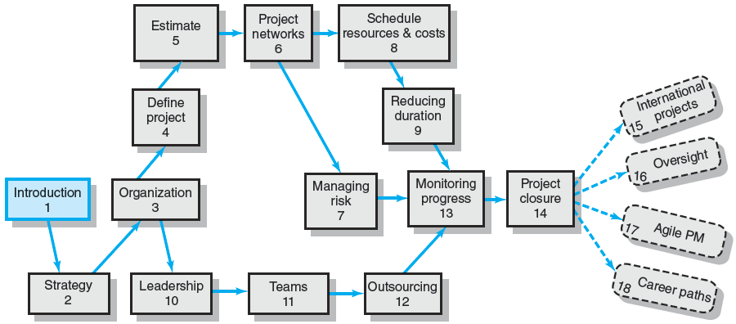
An Overview of Project Management 6e.

Slide 3
Chapter Objectives
To explain why project management is crucial in today’s world
To define a project and differentiate projects from routine operations
To establish the importance of projects in implementing organization strategy
To establish that managing projects is an act of balancing the technical and sociocultural sides of the project.

Slide 4
All of mankind’s greatest accomplishments —
from building the great pyramids
to discovering a cure for polio
to putting a man on the moon
— began as a project.

Slide 5
Project management provides people with a powerful set of tools that improves their ability to plan, implement, and manage activities to accomplish specific organizational objectives.
But project management is more than just a set of tools; it is a results-oriented management style that places a premium on building collaborative relationships among a diverse cast of characters.

Slide 6
What is a Project?
Project Defined
A complex, nonroutine, one-time effort limited by time, budget, resources, and performance specifications designed to meet customer needs.
Major Characteristics of a Project
Has an established objective.
Has a defined life span with a beginning and an end.
Requires across-the-organizational participation.
Involves doing something never been done before.
Has specific time, cost, and performance requirements.

Slide 7
What is Project Management? (PMBoK)
Project management is the application of knowledge, skills, tools, and techniques to project activities to meet the project requirements.
Project management is accomplished through the appropriate application and integration of the 47 logically grouped project management processes, which are categorized into five Process Groups.

Slide 8
Comparison of Routine Work with Projects
Routine, Repetitive Work
Taking class notes
Daily entering sales receipts into the accounting ledger
Responding to a supply-chain request
Practicing scales on the piano
Routine manufacture of an Apple iPod
Attaching tags on a manufactured product
Projects
Writing a term paper
Setting up a sales kiosk for a professional accounting meeting
Developing a supply-chain information system
Writing a new piano piece
Designing an iPod that is approximately 2 X 4 inches, interfaces with PC, and stores 10,000 songs
Wire-tag projects for GE and Wal-Mart
TABLE 1.1

Slide 9
Program versus Project
Program Defined
A series of coordinated, related, multiple projects that continue over an extended time and are intended to achieve a goal.
A higher level group of projects targeted at a common goal.
Examples:
Project: completion of a required course in project management.
Program: completion of all courses required for a business major.

Slide 10
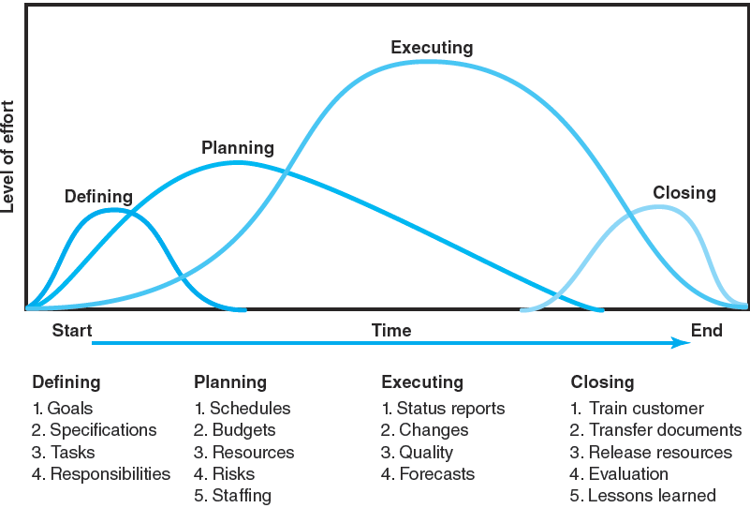
Project Life Cycle
FIGURE 1.1

Slide 11
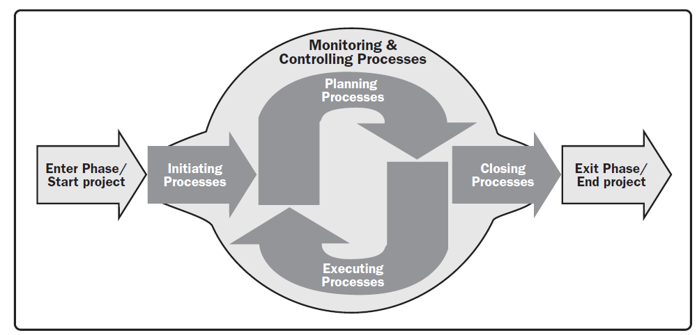
Project Management Process Groups (PMBoK)

Slide 12
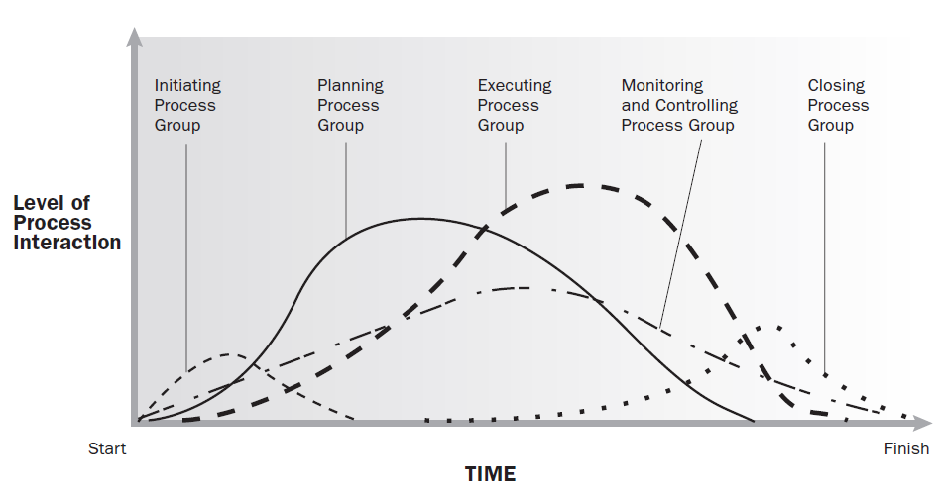
Process Groups Interact in a Phase or Project (PMBoK)

Slide 13
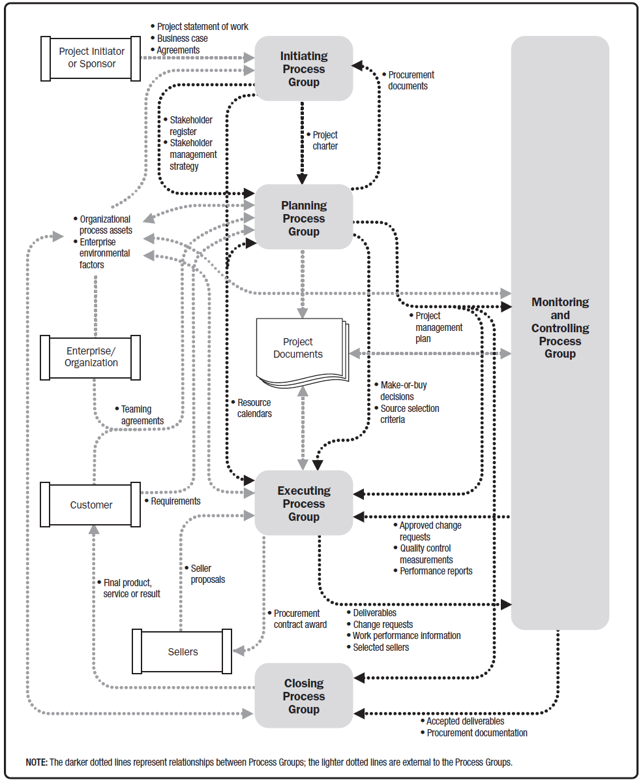
Project Management Process Interactions (PMBoK)

Slide 14
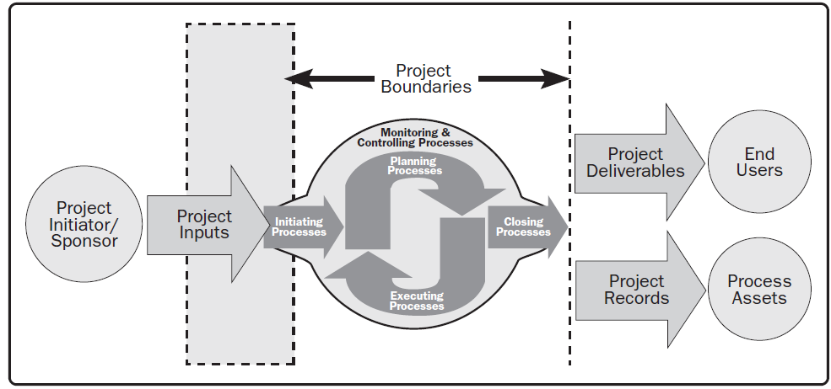
Project Boundaries (PMBoK)

Slide 15
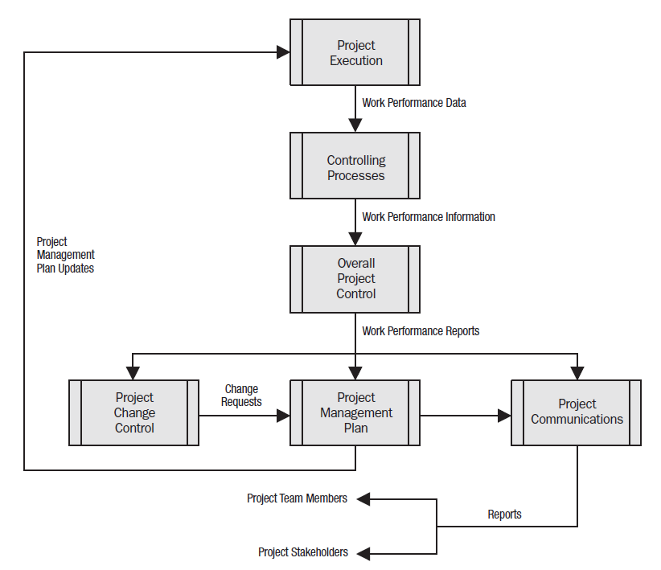
Project Data, Information and Report Flow (PMBoK)

Slide 16
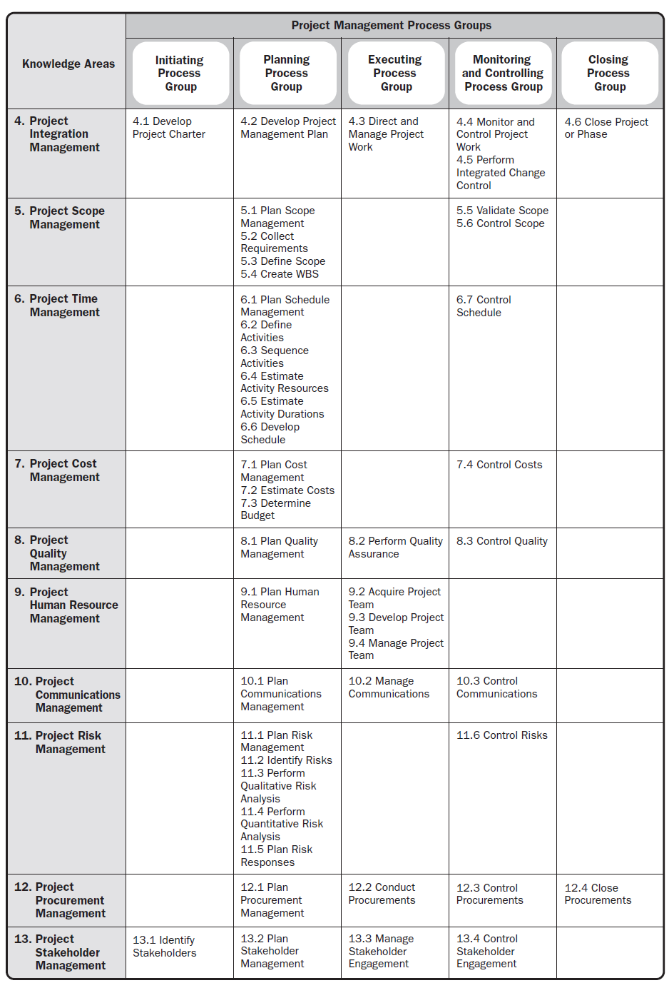
Project Management Process Group and Knowledge Area Mapping (PMBoK)

Slide 17
The Challenge of Project Management
The Project Manager
Manages temporary, non-repetitive activities and frequently acts independently of the formal organization.
Marshals resources for the project.
Is linked directly to the customer interface.
Provides direction, coordination, and integration to the project team.
Is responsible for performance and success of the project.
Must induce the right people at the right time to address the right issues and make the right decisions.

Slide 18
Current Drivers of Project Management
Factors leading to the increased use of project management:
Compression of the product life cycle
Knowledge explosion
Triple bottom line (planet, people, profit)
Corporate downsizing
Increased customer focus
Small projects represent big problems

Slide 19
Project Governance: An Integrative Approach
Integration (or centralization) of project management provides senior management with:
An overview of all project management activities
A big picture of how organizational resources are used
A risk assessment of their portfolio of projects
A rough metric of the firm’s improvement in managing projects relative to others in the industry
Linkages of senior management with actual project execution management

Slide 20
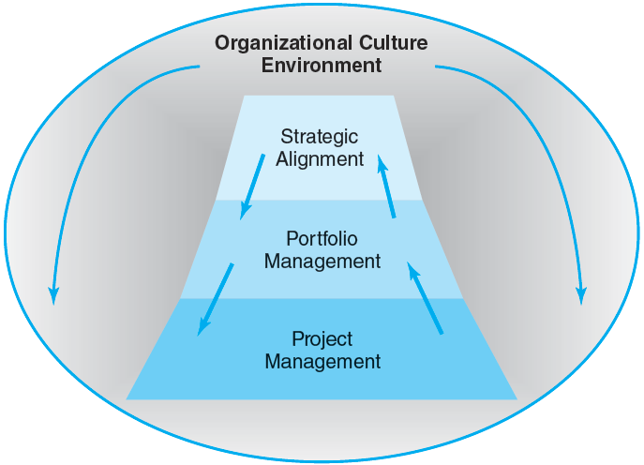
Integrated Management of Projects
FIGURE 1.2

Slide 21
Alignment of Projects with Organizational Strategy
Problems resulting from the uncoordinated project management systems include:
Projects that do not support the organization’s overall strategic plan and goals.
Independent managerial decisions that create internal imbalances, conflicts and confusion resulting in dissatisfied customers.
Failure to prioritize projects results in the waste of resources on non-value-added activities/projects.

Slide 22
Major Functions of Portfolio Management: The “Science” and “Art” of Project Management
Oversee project selection.
Monitor aggregate resource levels and skills.
Encourage use of best practices.
Balance projects in the portfolio in order to represent a risk level appropriate to the organization.
Improve communication among all stakeholders.
Create a total organization perspective that goes beyond silo thinking.
Improve overall management of projects over time.

Slide 23
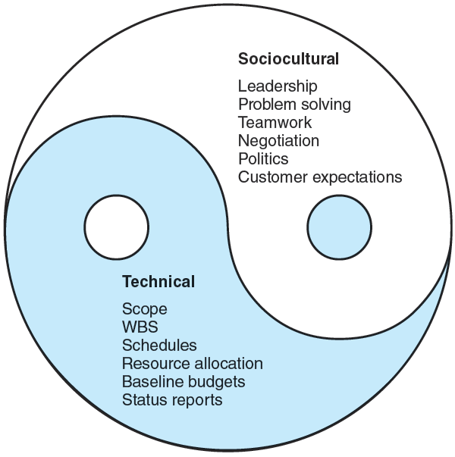

The Technical and Sociocultural Dimensions of the Project Management Process
FIGURE 1.3

Slide 24
Key Terms
Program
Project
Project life cycle
Project Management Professional (PMP)

